Slide 1
M7

Slide 2

Mineral Riches in the Soil
Rocks are broken down by various physical, chemical and some biological processes forming soil.
Sun
Water
Wind
Living organisms

Slide 3

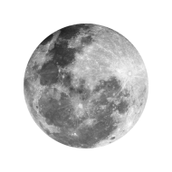
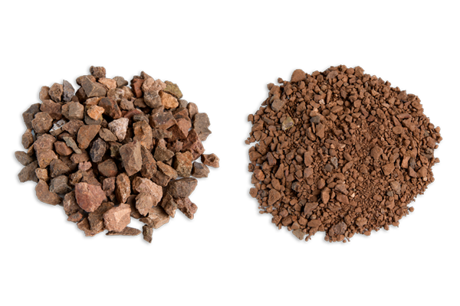
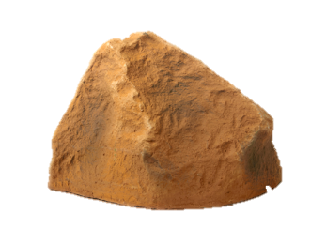
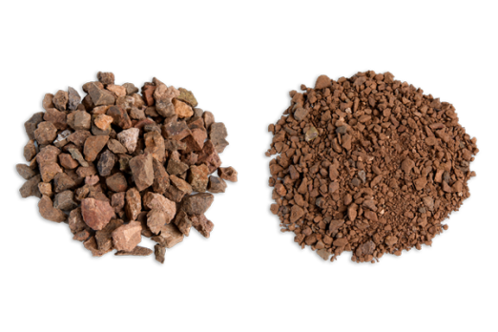
Mineral Riches in the Soil
Rocks are broken down by various physical, chemical and some biological processes forming soil.
Sun
Water
Wind
Living organisms
Since all parts of the rock do not expand and contract at the same rate, this results in the formation of cracks and ultimately the huge rocks break up into smaller pieces.
At night, these rocks cool down and contract.
The Sun heats up rocks during the day so that they expand.

Slide 4
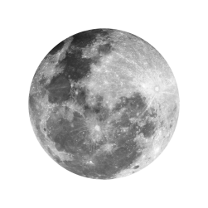

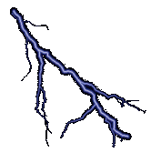
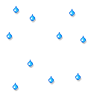

Mineral Riches in the Soil
Rocks are broken down by various physical, chemical and some biological processes forming soil.
Sun
Water
Wind
Living organisms
If this water later freezes, it would cause the cracks to widen thus the rocks break and form soil.
One, water could get into the cracks in the rocks formed due to uneven heating by the Sun.
Water helps in the formation of soil in two ways.
Soil

Slide 5
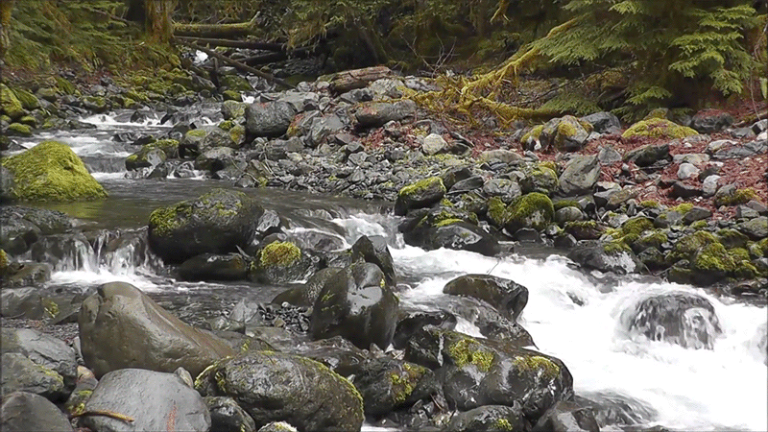
Mineral Riches in the Soil
Rocks are broken down by various physical, chemical and some biological processes forming soil.
Sun
Water
Wind
Living organisms
These rocks rub against other rocks and the resultant abrasion causes the rocks to wear down into smaller and smaller particles.
Fast flowing water often carries big and small particles of rock downstream.
Flowing water wears away even hard rock over long periods of time.
Friction

Slide 6
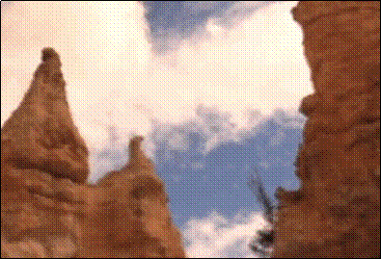
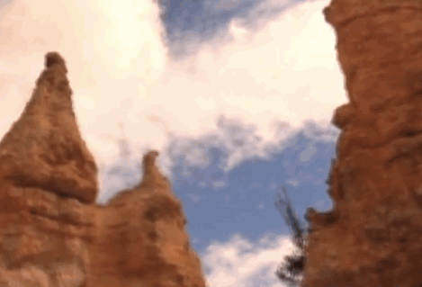
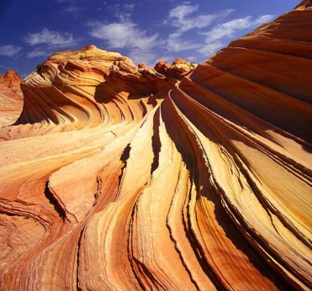
Mineral Riches in the Soil
Rocks are broken down by various physical, chemical and some biological processes forming soil.
Sun
Water
Wind
Living organisms
Strong winds also erode rocks down.
The wind also carries sand from one place to the other like water does.

Slide 7
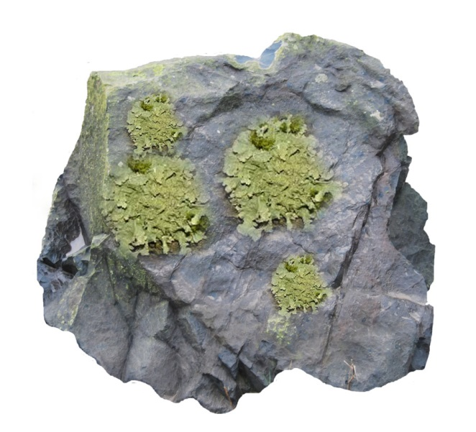
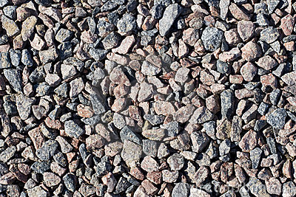
Mineral Riches in the Soil
Rocks are broken down by various physical, chemical and some biological processes forming soil.
Sun
Water
Wind
Living organisms
While growing, they release certain substances that cause the rock surface to powder down and form a thin layer of soil.
Living organisms also influence the formation of soil.
The lichen grows on the surface of rocks.

Slide 8
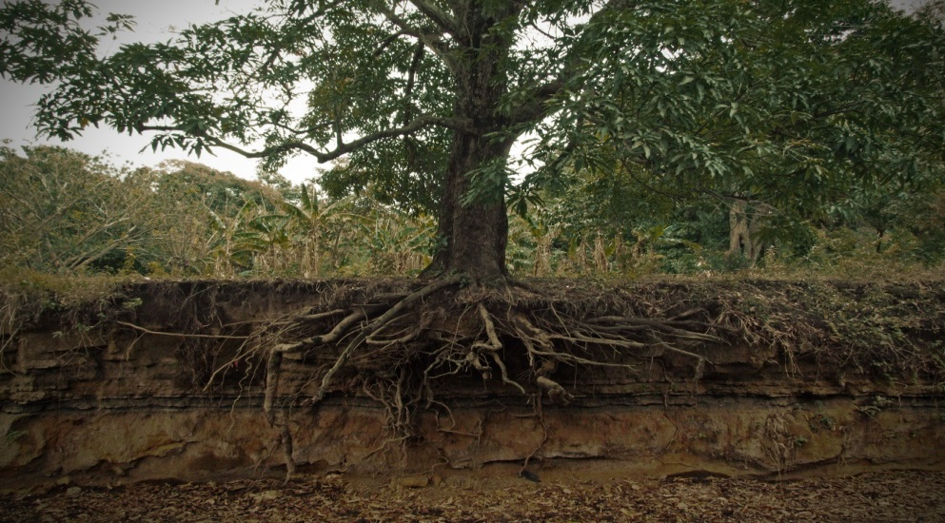
Mineral Riches in the Soil
Rocks are broken down by various physical, chemical and some biological processes forming soil.
Sun
Water
Wind
Living organisms
The roots of big trees sometimes go into cracks in the rocks and as the roots grow bigger the cracks is forced bigger.

Slide 9
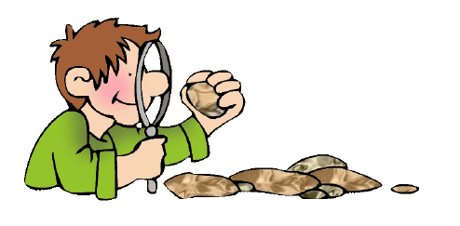
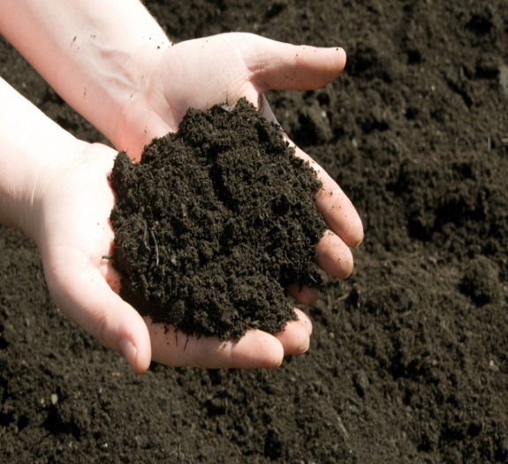
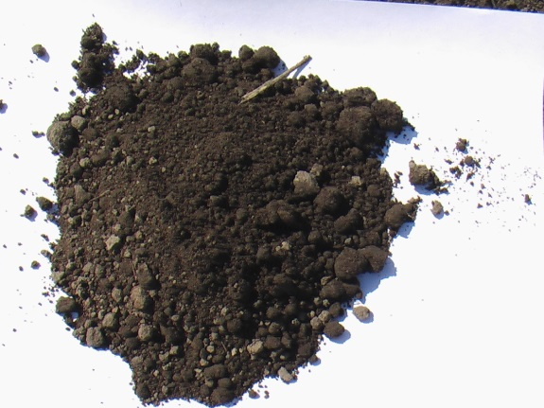
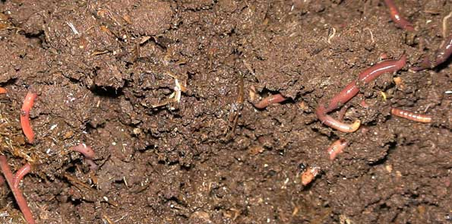
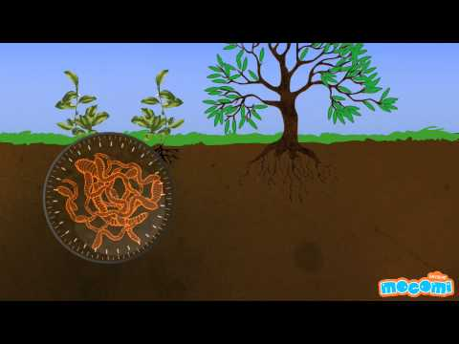
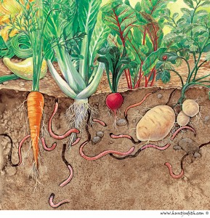
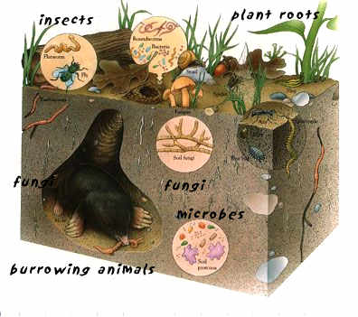
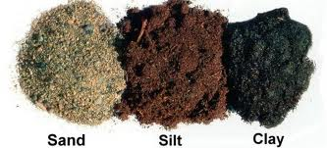
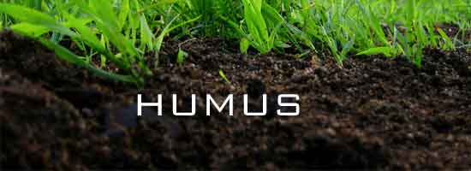
Soil
Soil is a mixture.
It contains smaller particles of rock(of different sizes)
It also contains bits of decayed living organisms which is called humus.
In addition, soil also contains various forms of microscopic life.
The type of soil is decided by the average size of particles found in it.
And the quality of the soil is decided by the amount of humus and the microscopic organisms found in it.

Slide 10
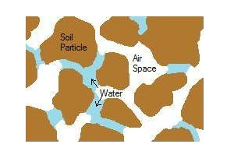
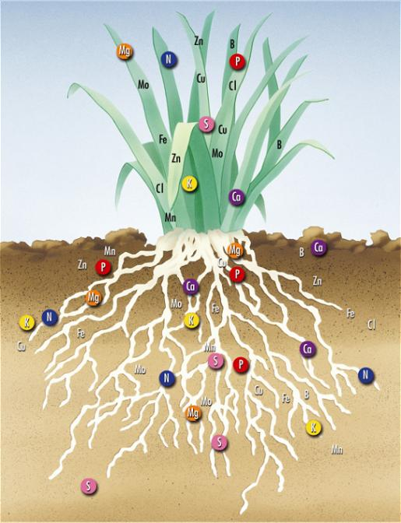
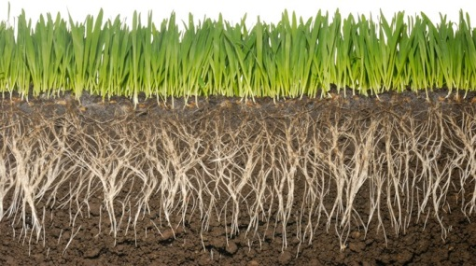
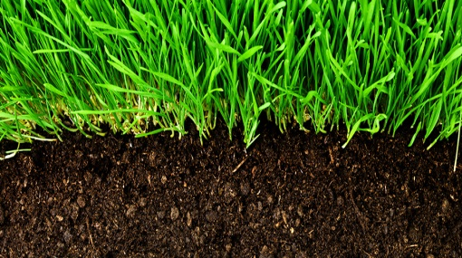
Soil
Humus is a major factor in deciding the soil structure because it causes the soil to become more porous and allows water and air to penetrate deep underground.
The mineral nutrients that are found in a particular soil depends on the rocks it was formed from.
The nutrient content of a soil, the amount of humus present in it and the depth of the soil are some of the factors that decide which plants will thrive on that soil.

Slide 11
Soil
Thus, the topmost layer of the soil that contains humus and living organisms in addition to the soil particles is called the topsoil.
The quality of the topsoil is an important factor that decides biodiversity in that area.

